Slide 1
LED Ticker Displays

Slide 2
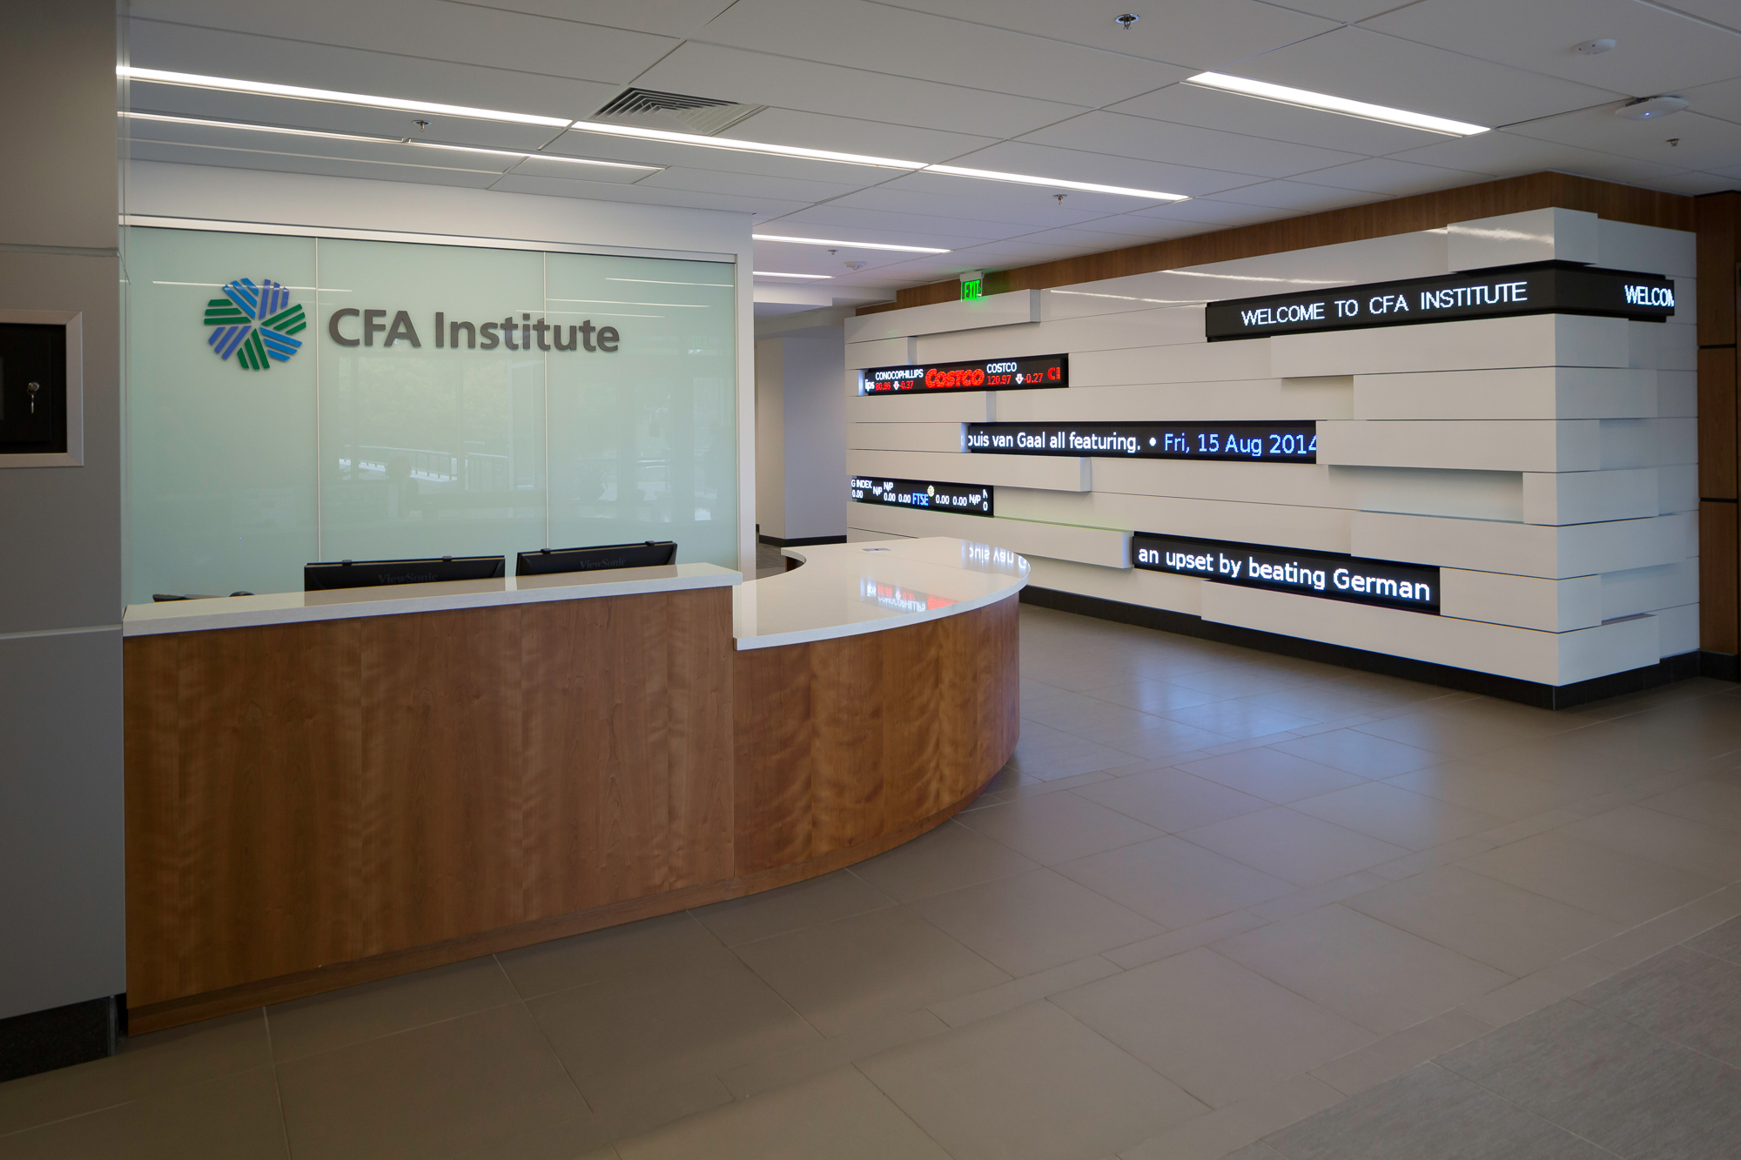
Your clients want to create an exciting environment.

Slide 3
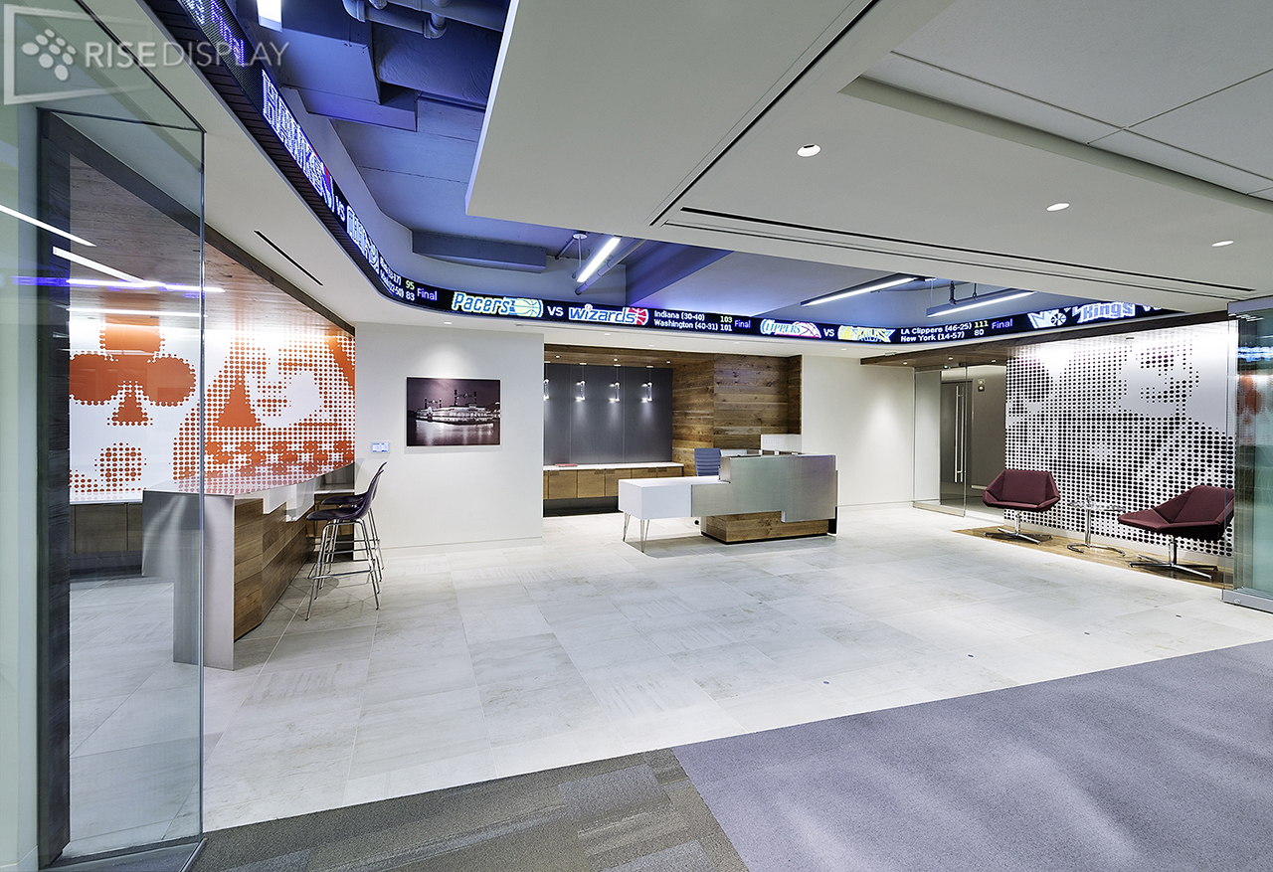
To do that
they need
eye-catching technology.

Slide 4
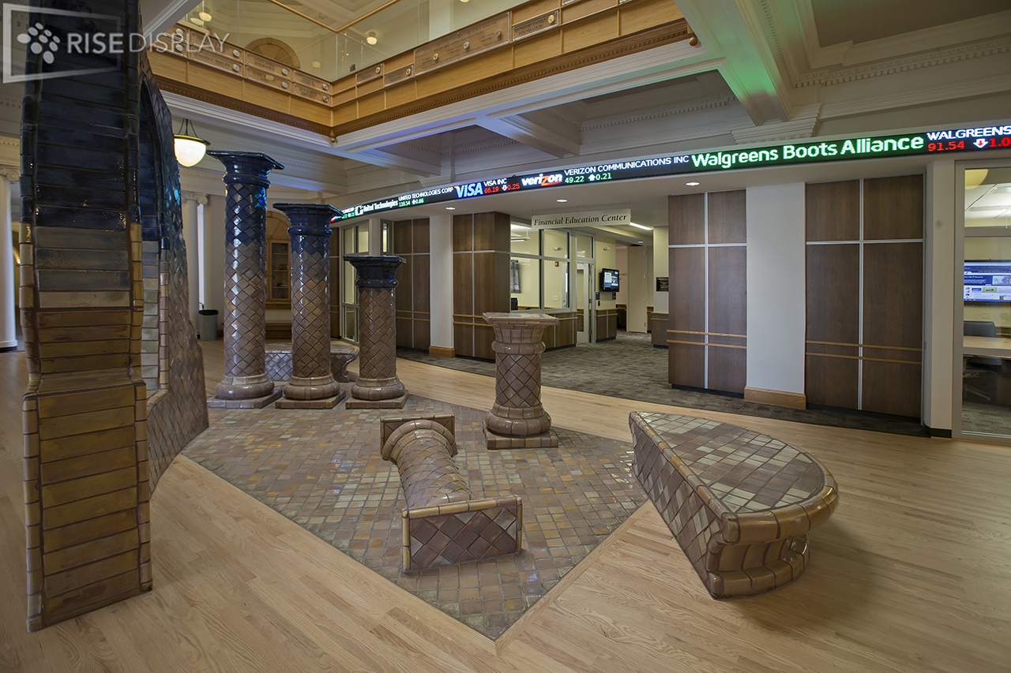
We specialize in LED Tickers.

Slide 5
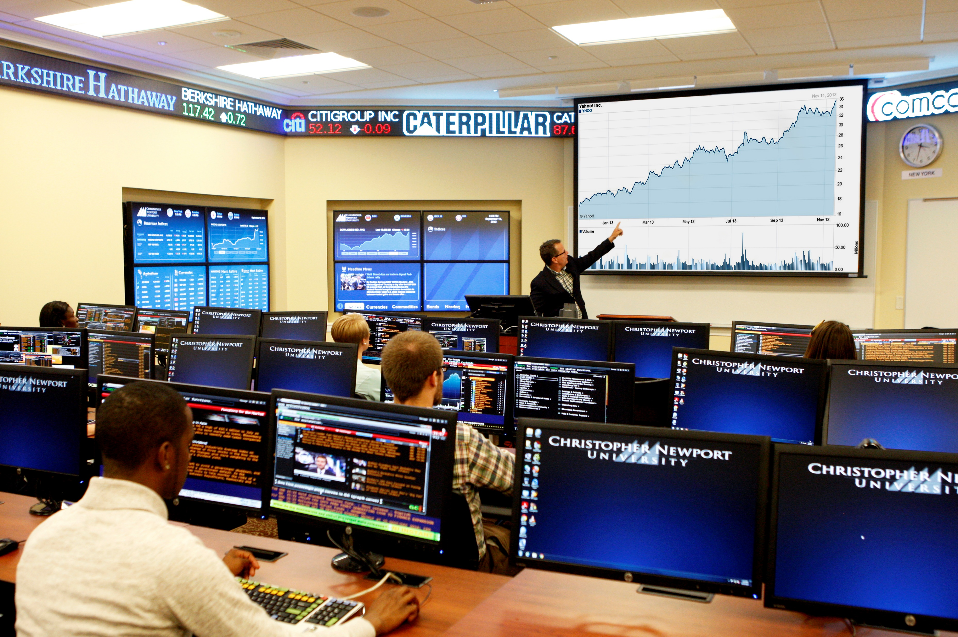
Make it easy for you to include in your AV solution.

Slide 6
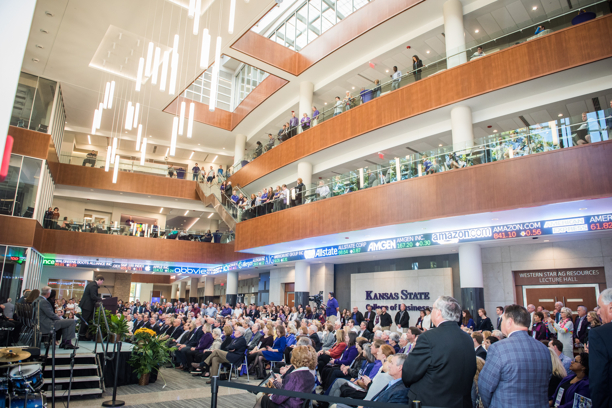
We have helped thousands of clients across North America.

Slide 7
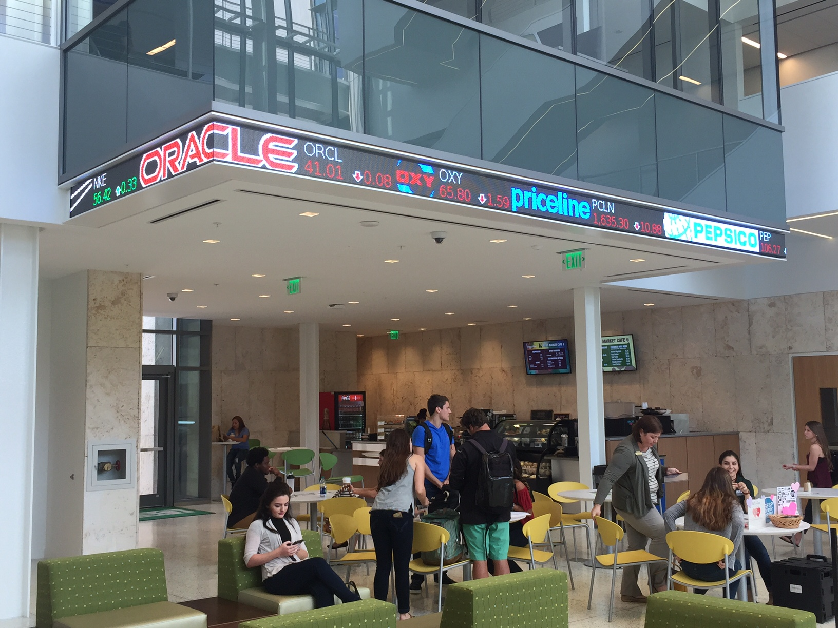
High Schools
&
Universities

Slide 8
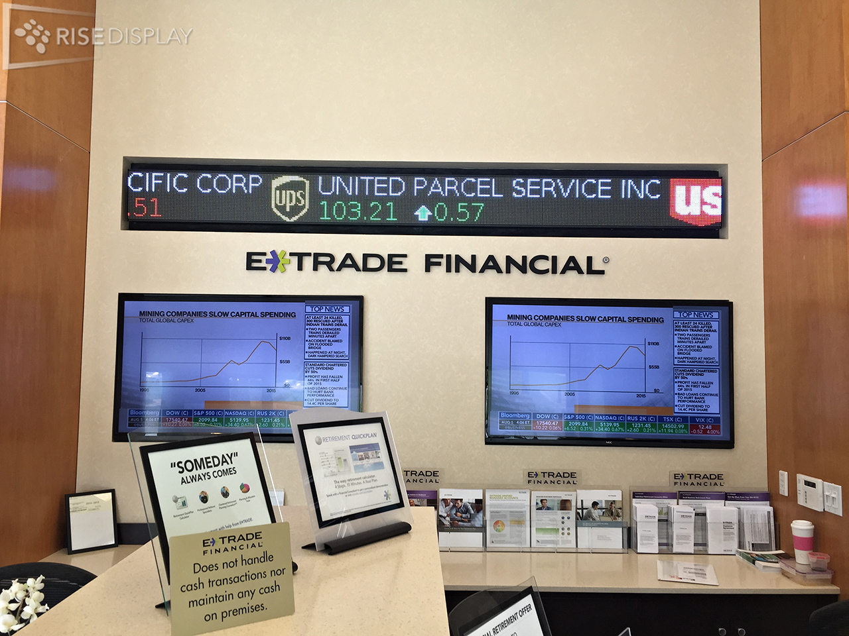
Financial
&
Banking

Slide 9
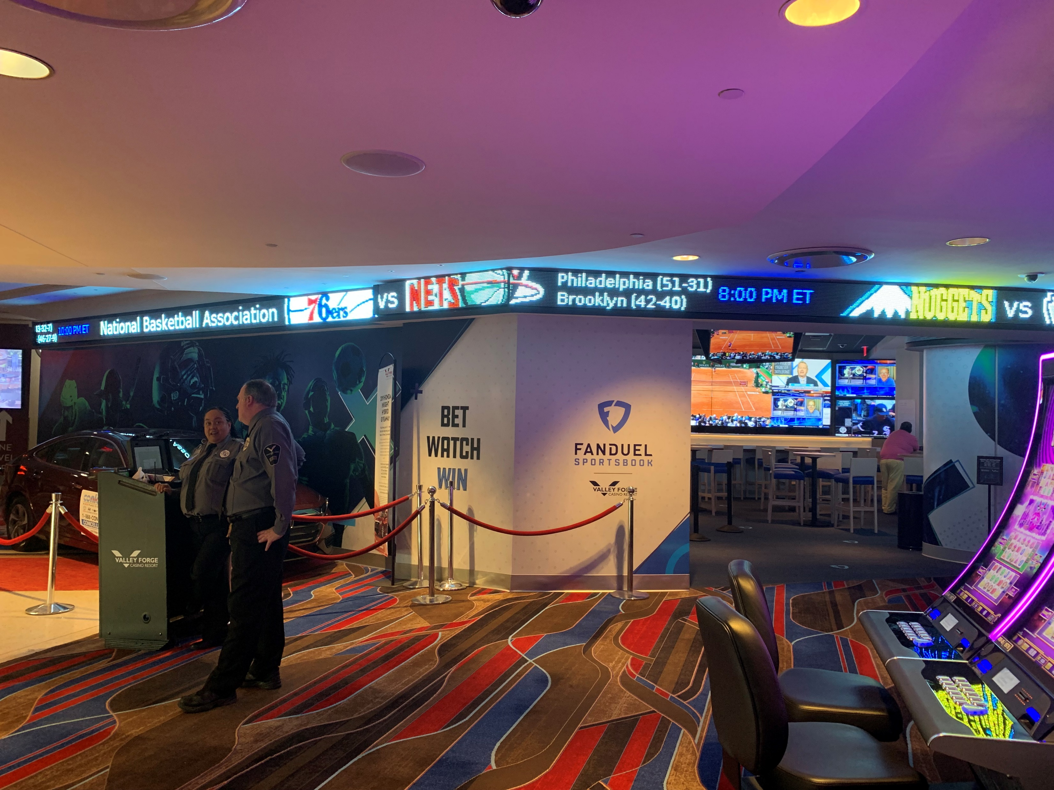
Sports Bars
&
Casinos

Slide 10
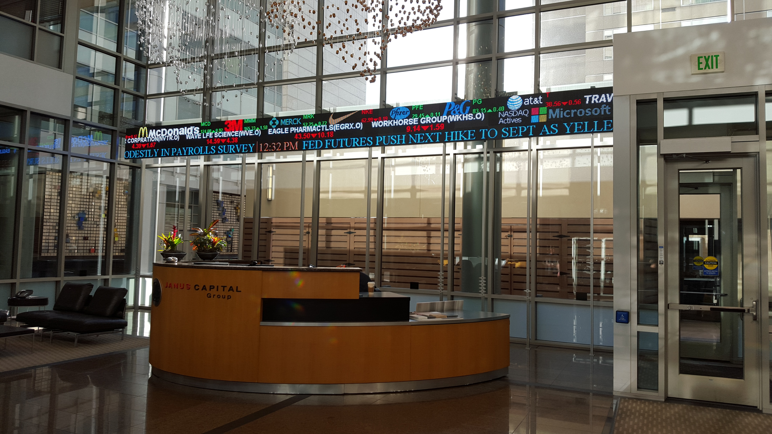
Corporate
&
Lobbies

Slide 11
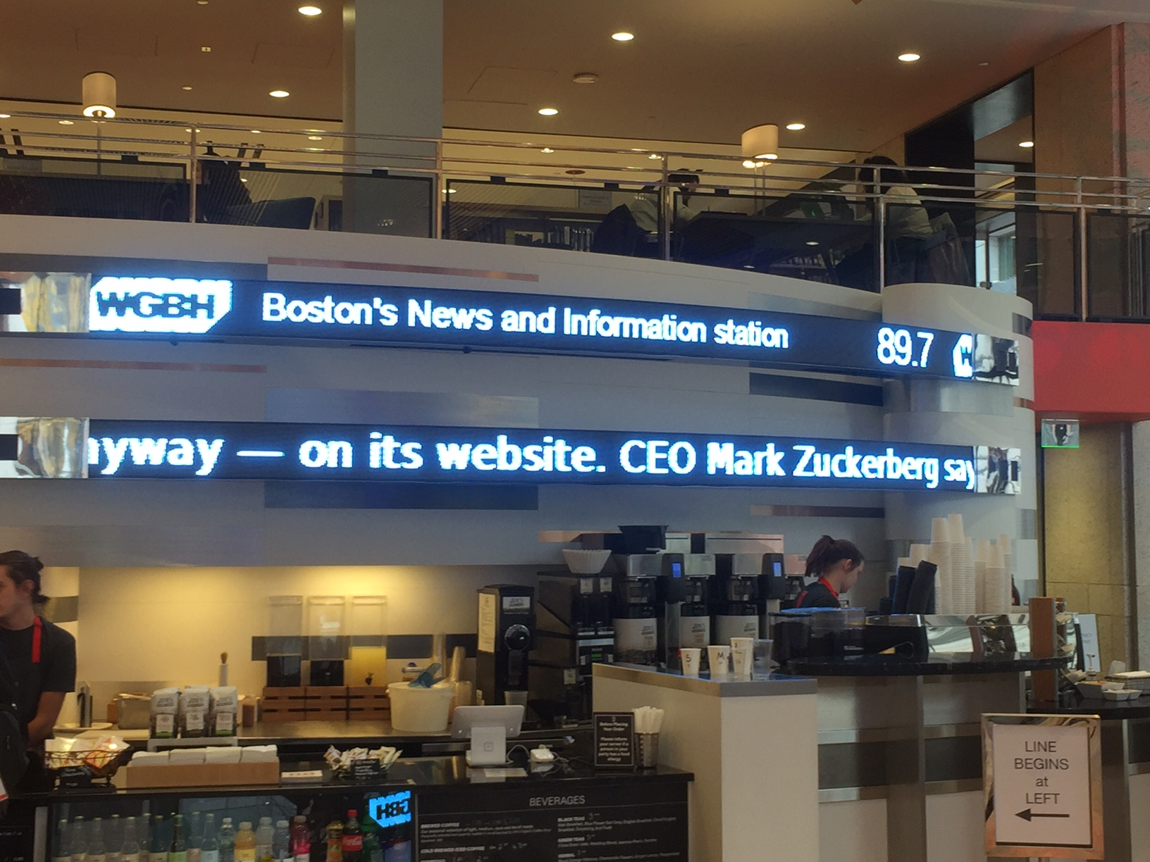
Retail
&
Public Spaces

Slide 12
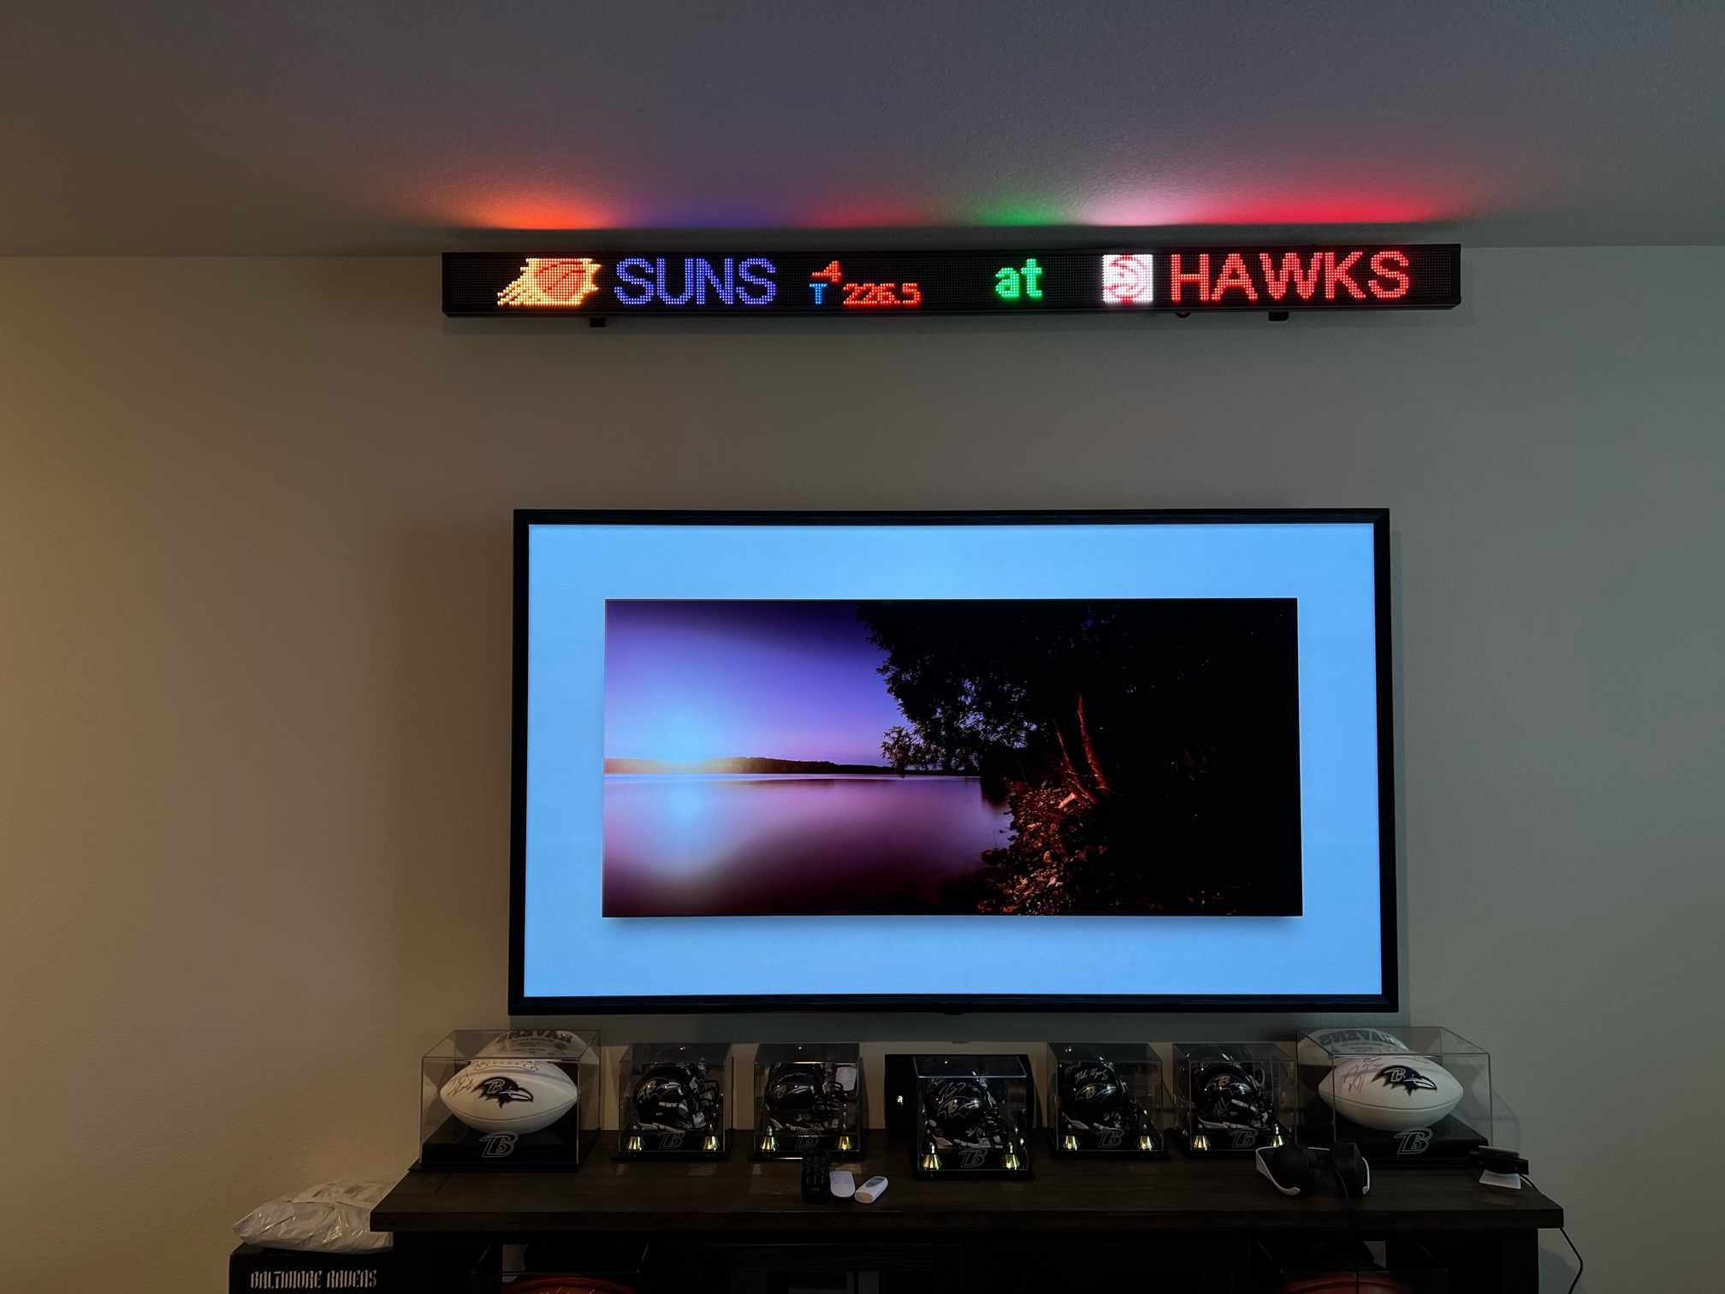
Home Offices
&
Mancaves

Slide 13
3 simple steps to get a budget

Slide 14
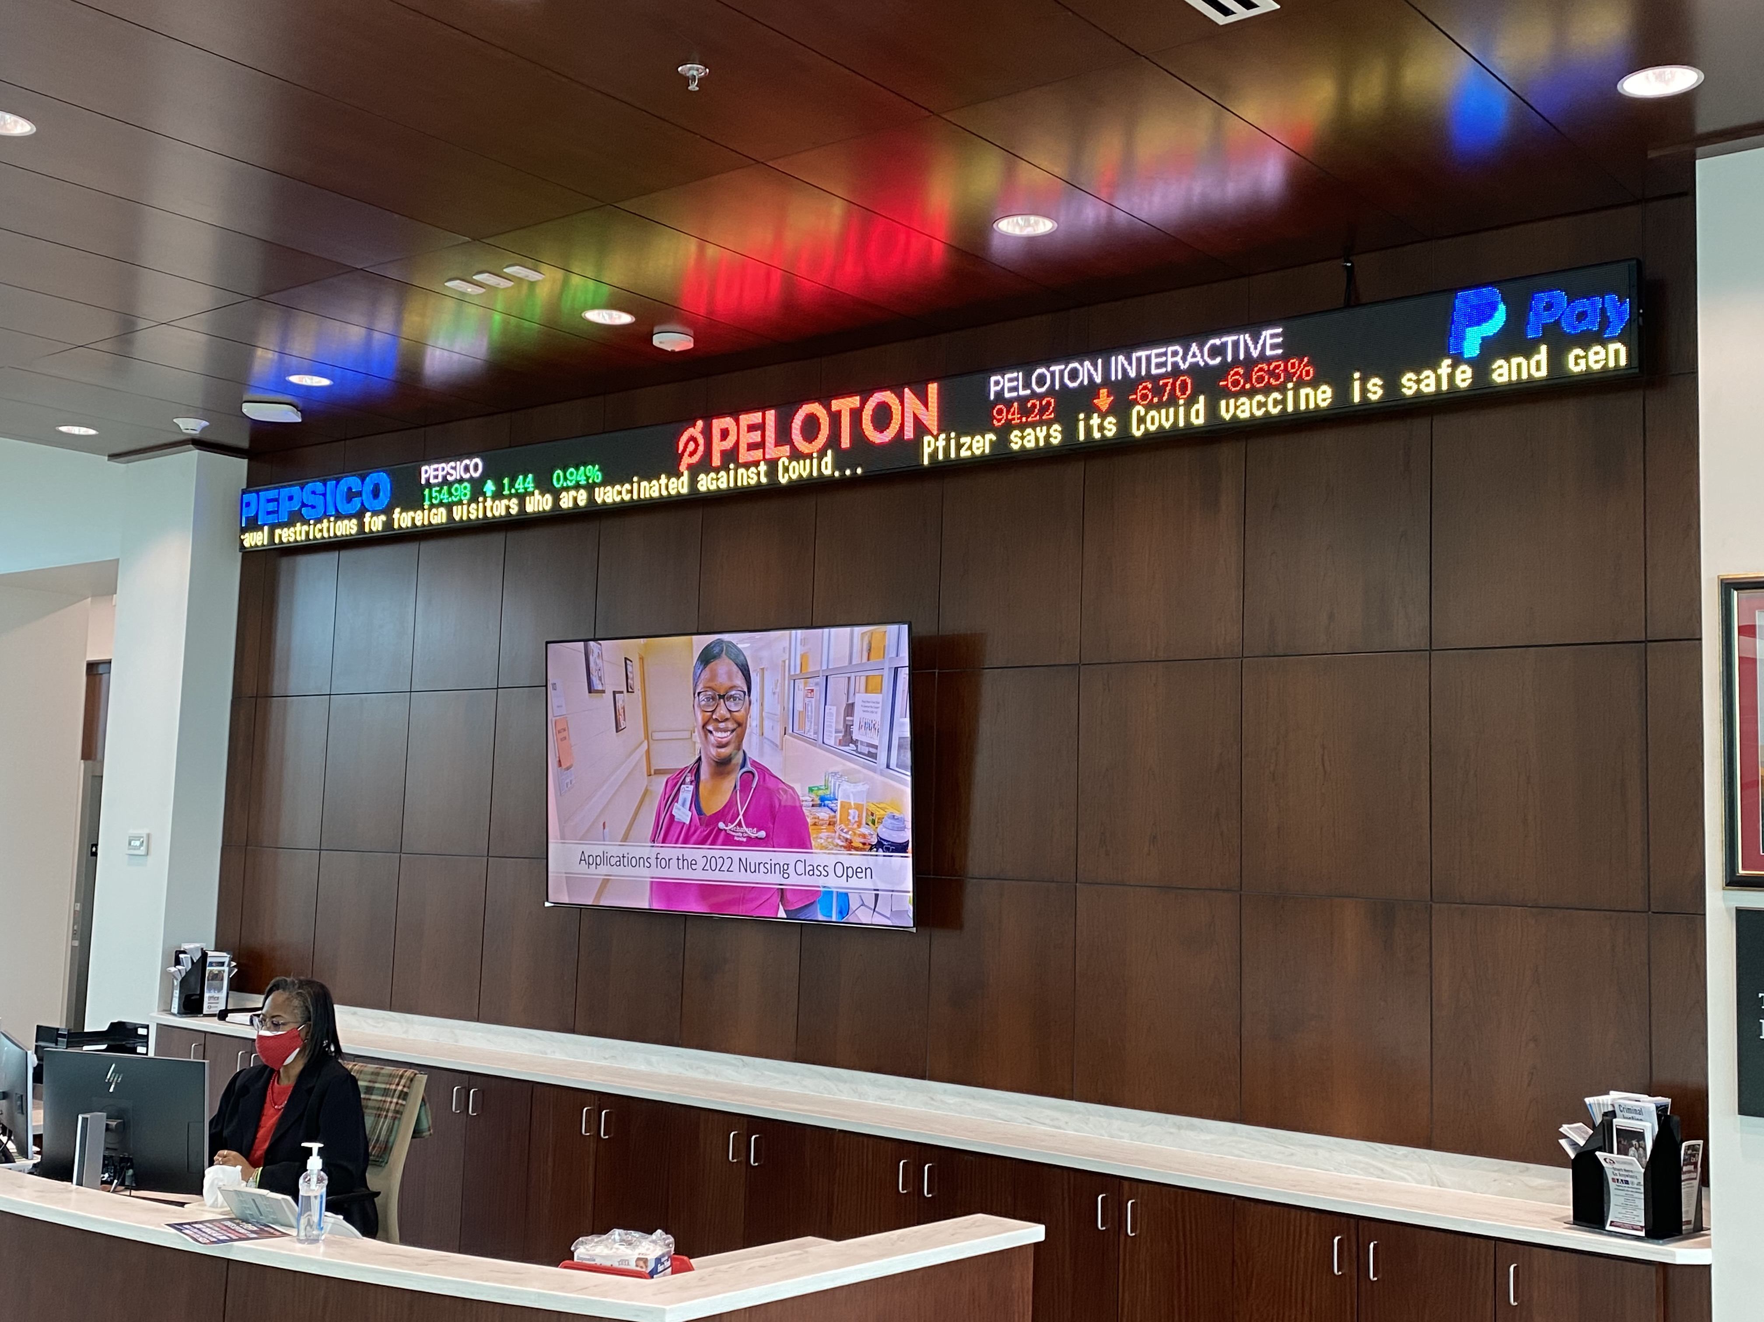
Step 1:
Define the ideal height
$400 to $1,000 per foot for standard sizes

Slide 15
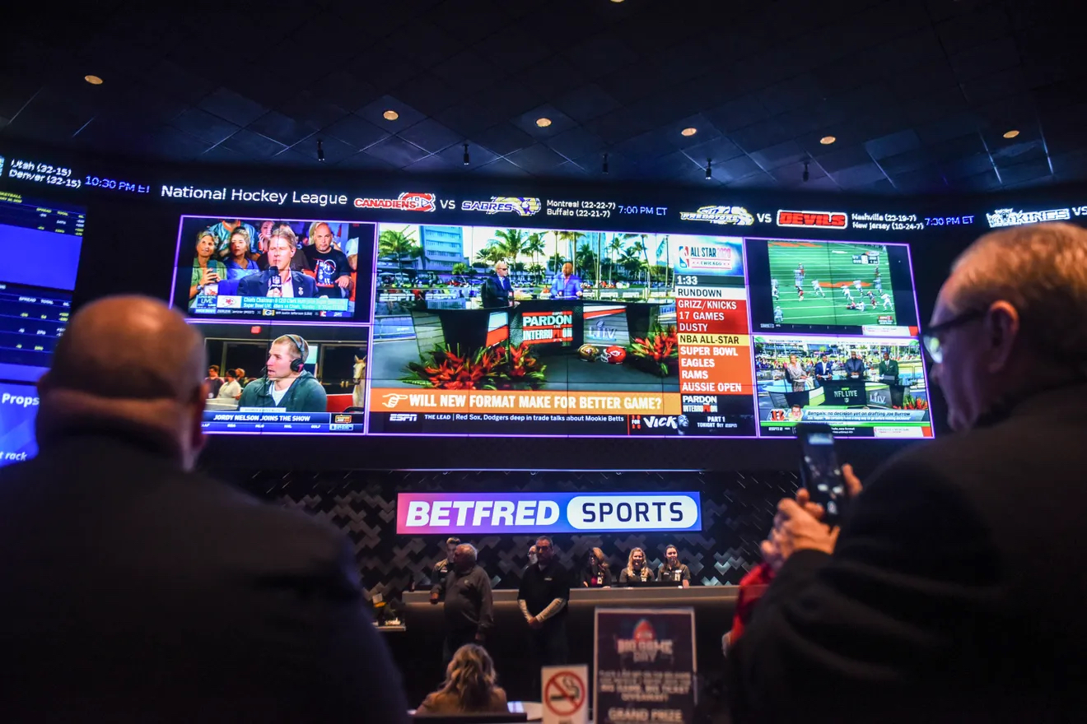
Step 2:
Define the ideal length

Slide 16
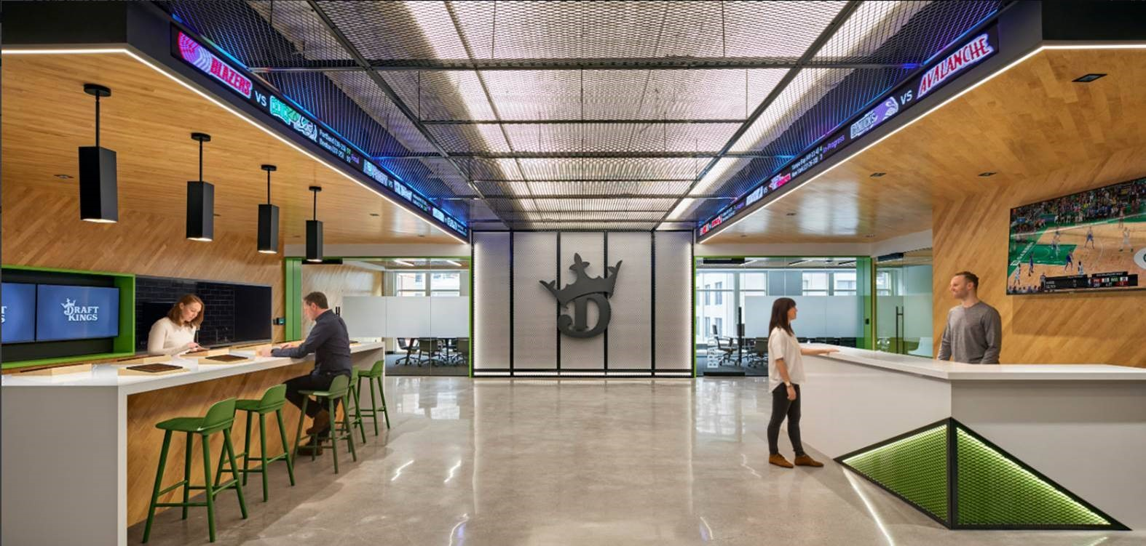
Step 3:
Select the style of ticker
Straight

Slide 17
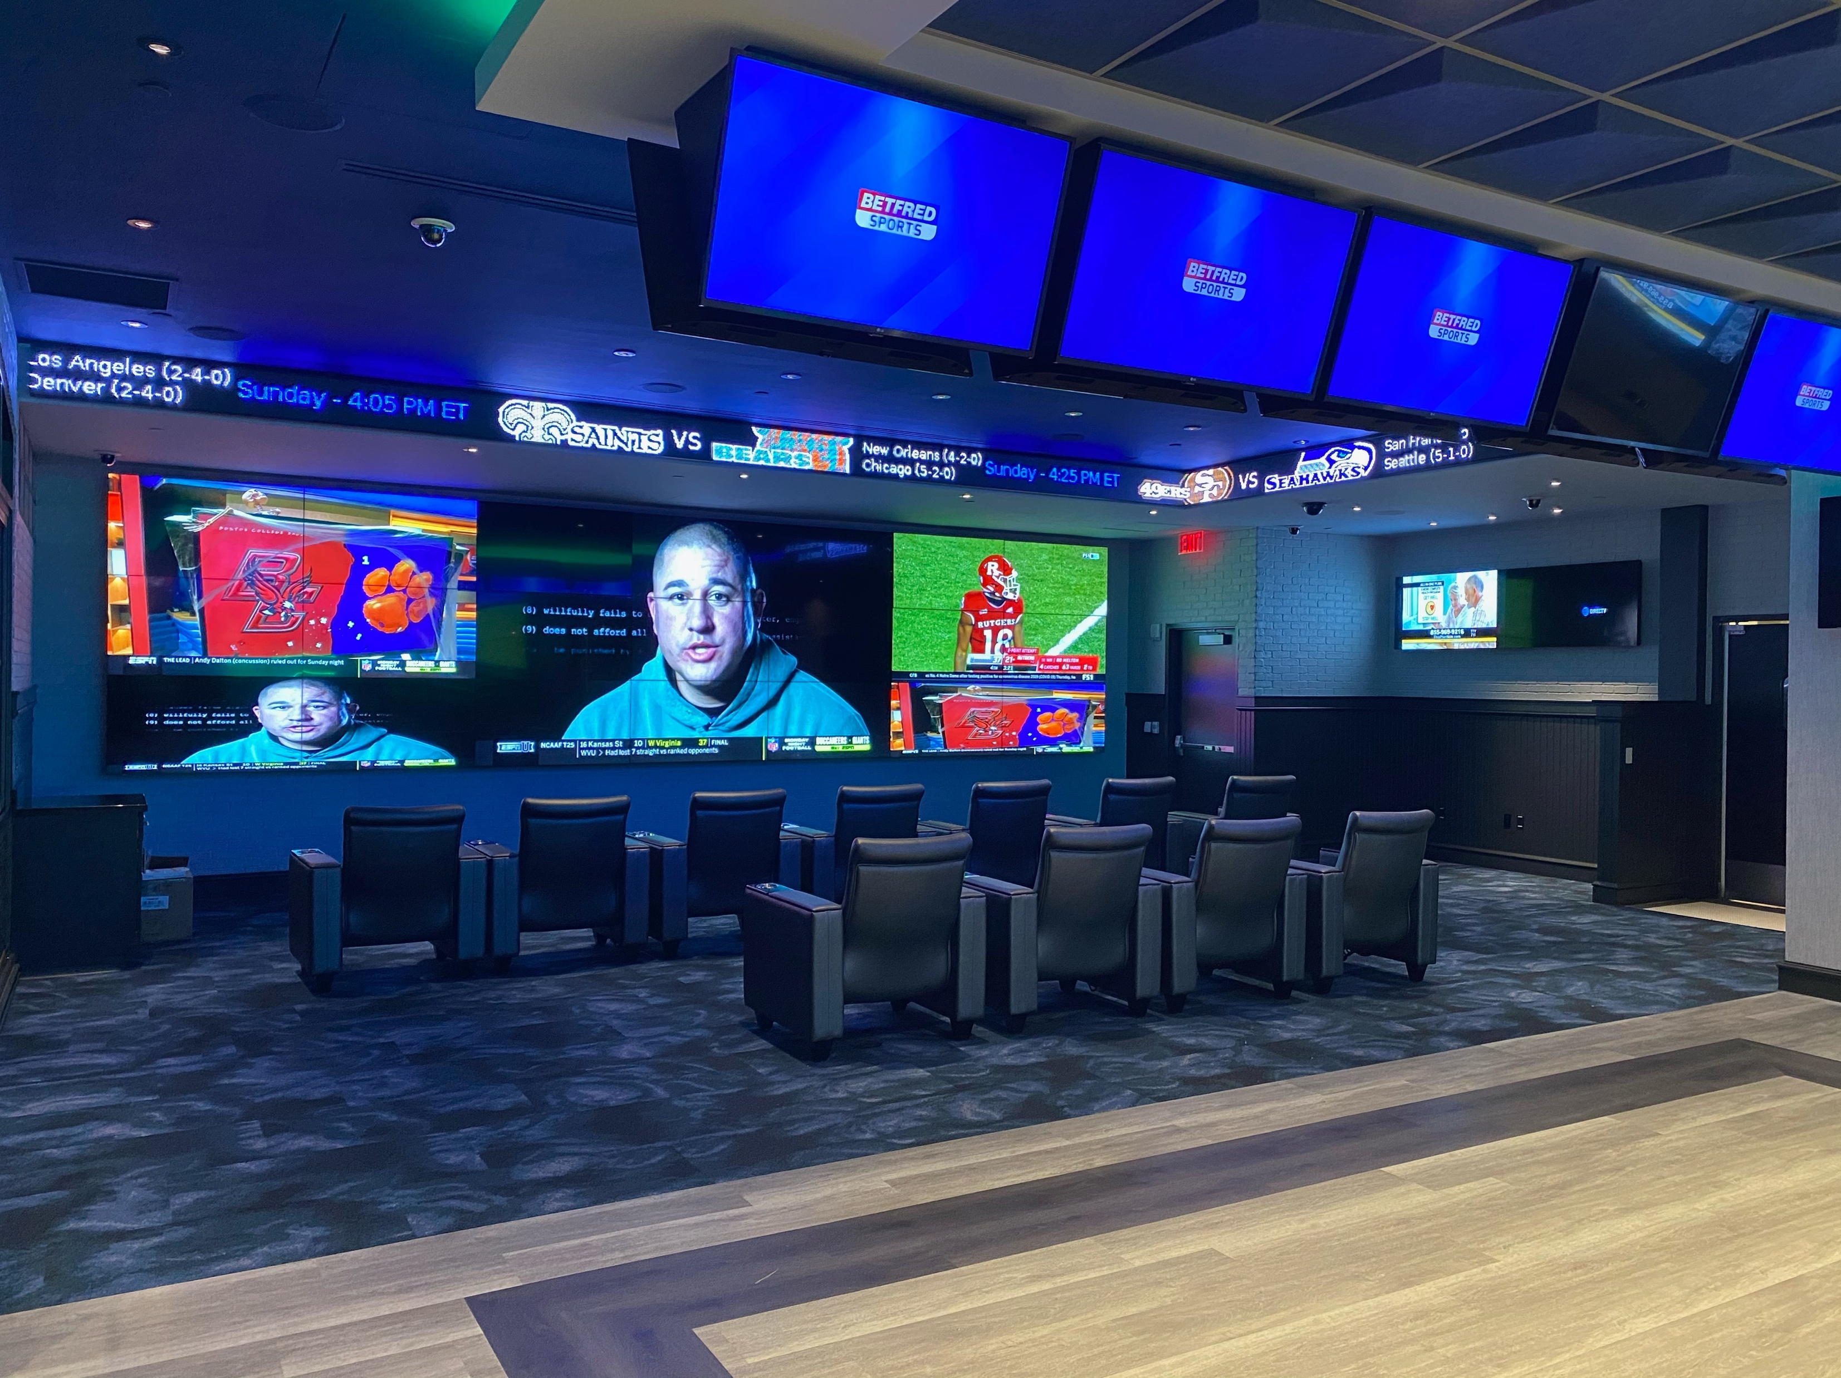
Select the style of ticker
Wrap Corners

Slide 18
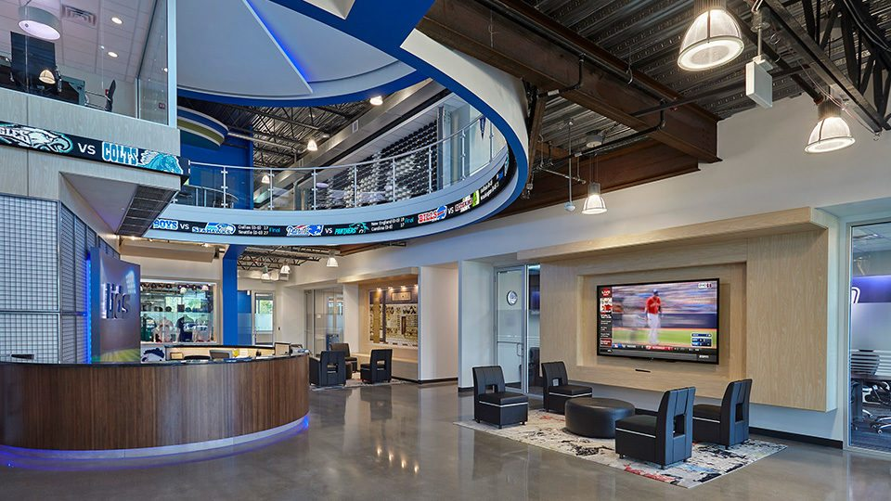
Select the style of ticker
Flexible Curved

Slide 19
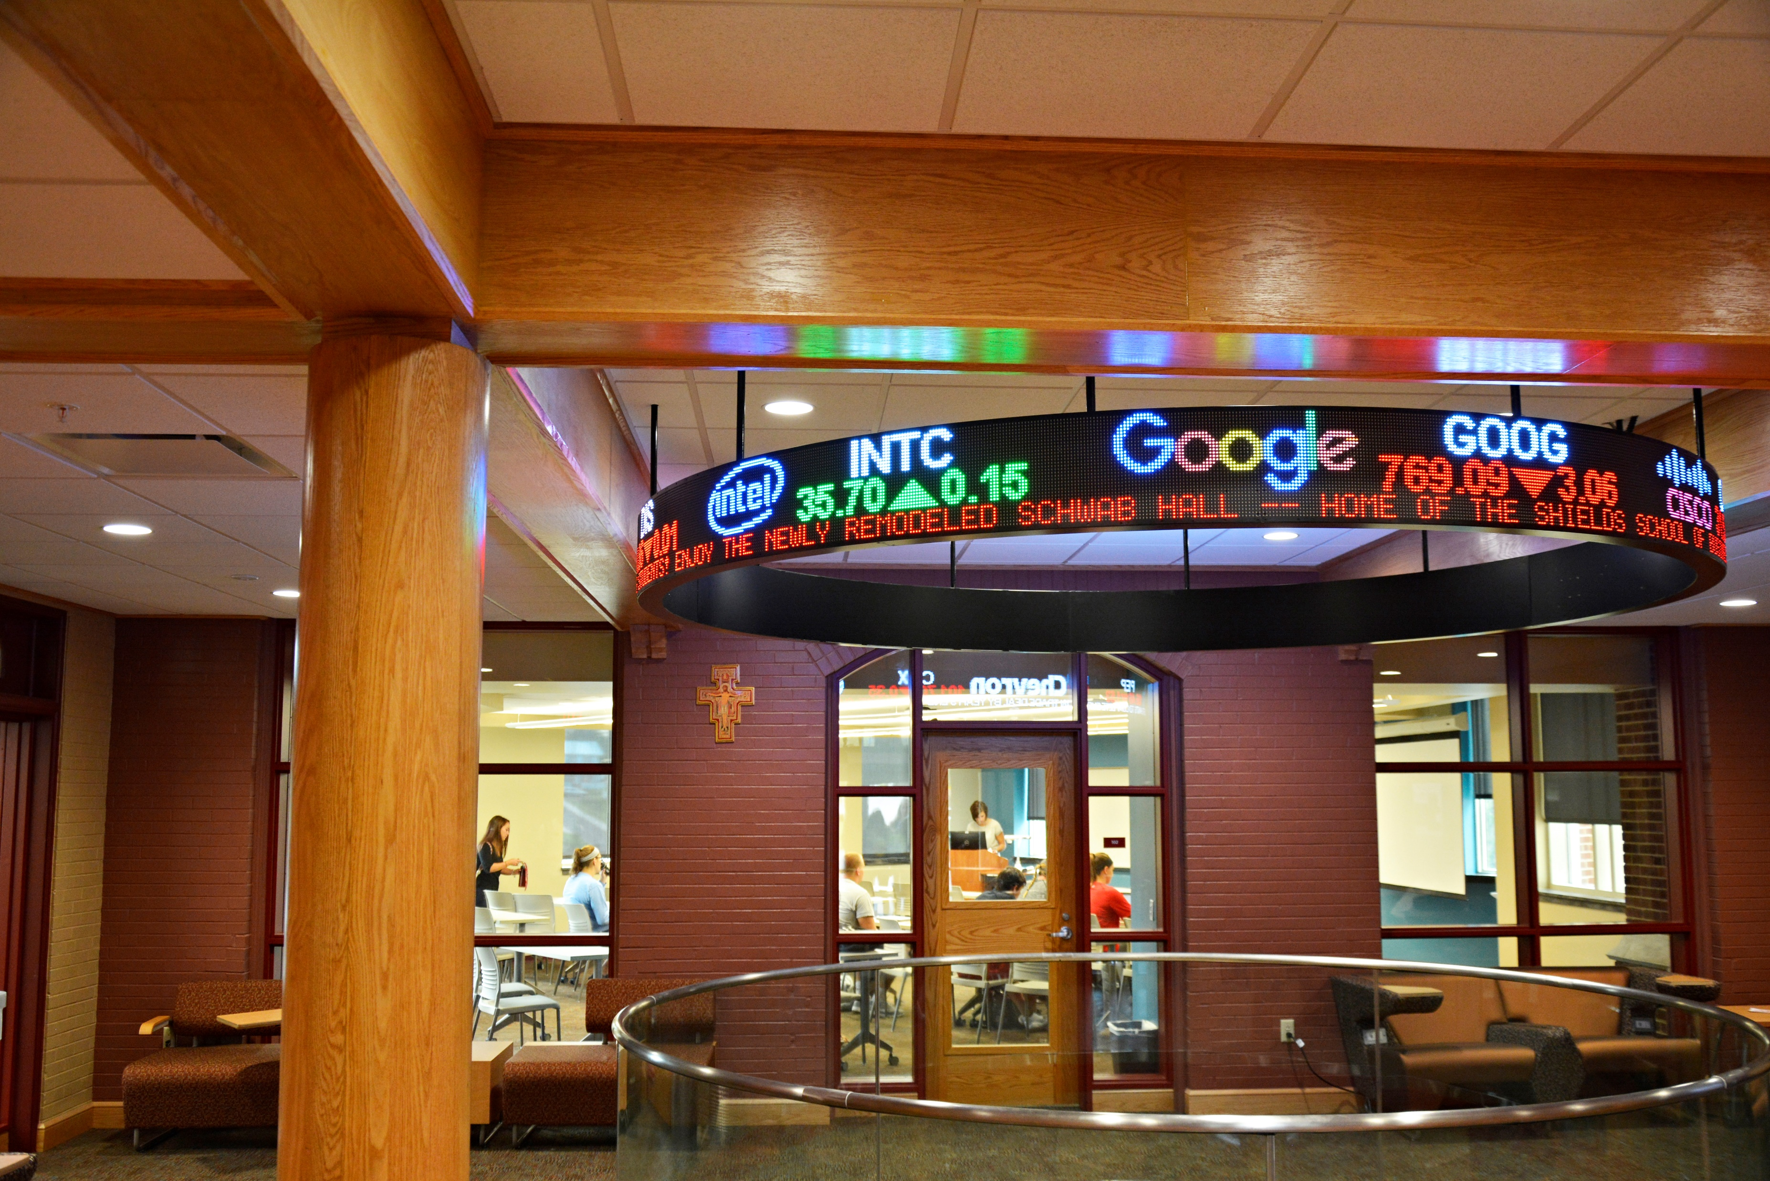
Select the style of ticker
Circular

Slide 20
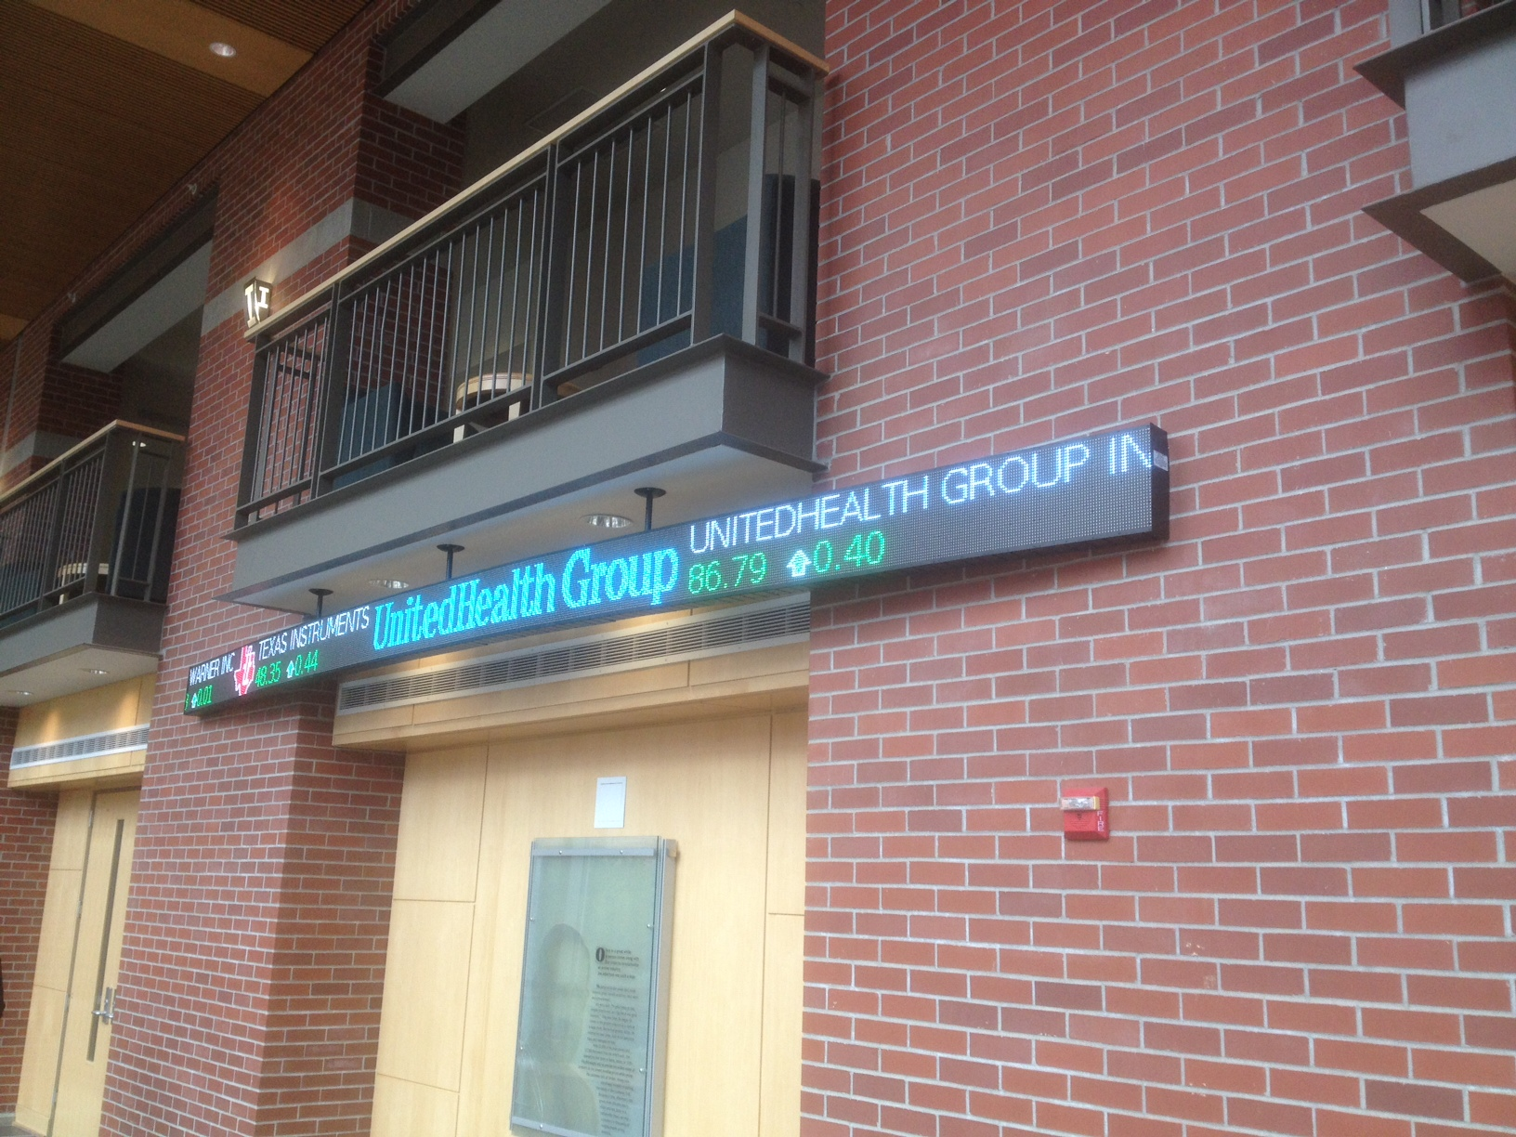
Select the style of ticker
Ceiling Mounted

Slide 21
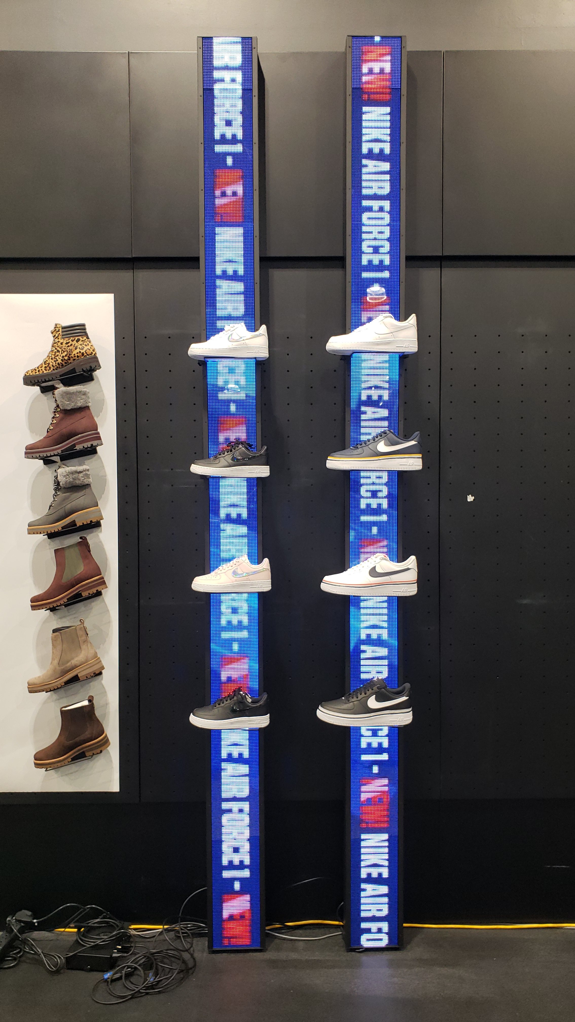
Select the style of ticker
Vertical

Slide 22
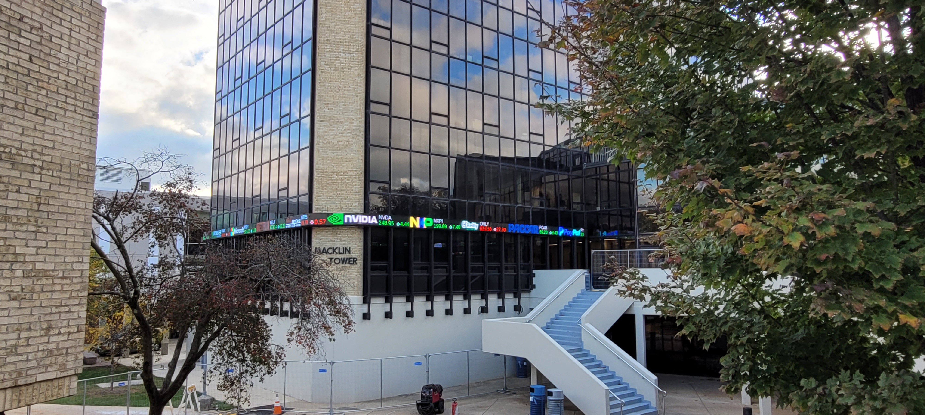
Select the style of ticker
Outdoor

Slide 23
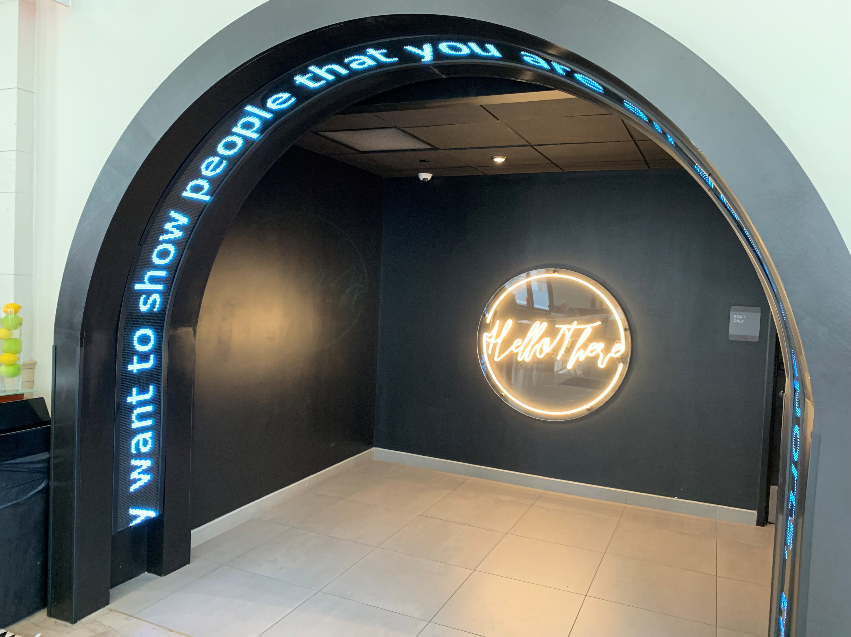
Select the style of ticker
Custom engineered

Slide 24
Rise Ticker App

Slide 25
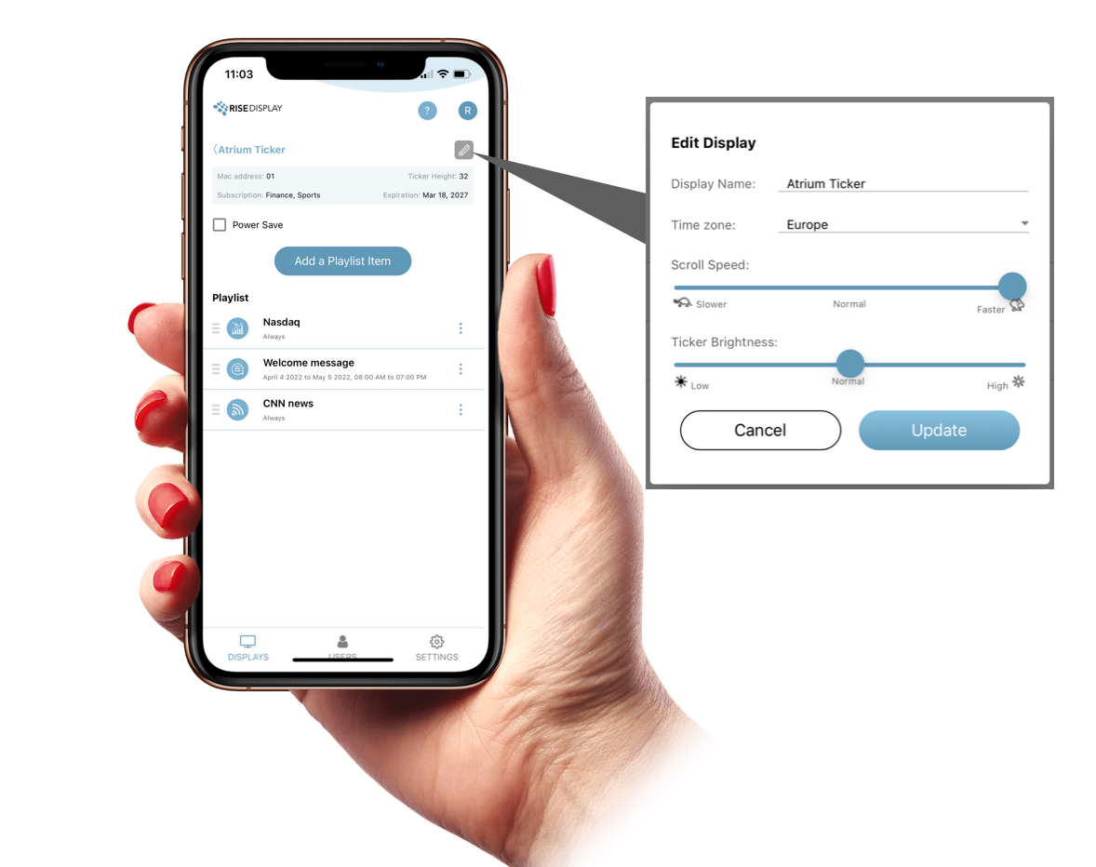
Rise Ticker
App
Set time zone
Power Save settings
Adjust scroll speed
Optimize brightness

Slide 26
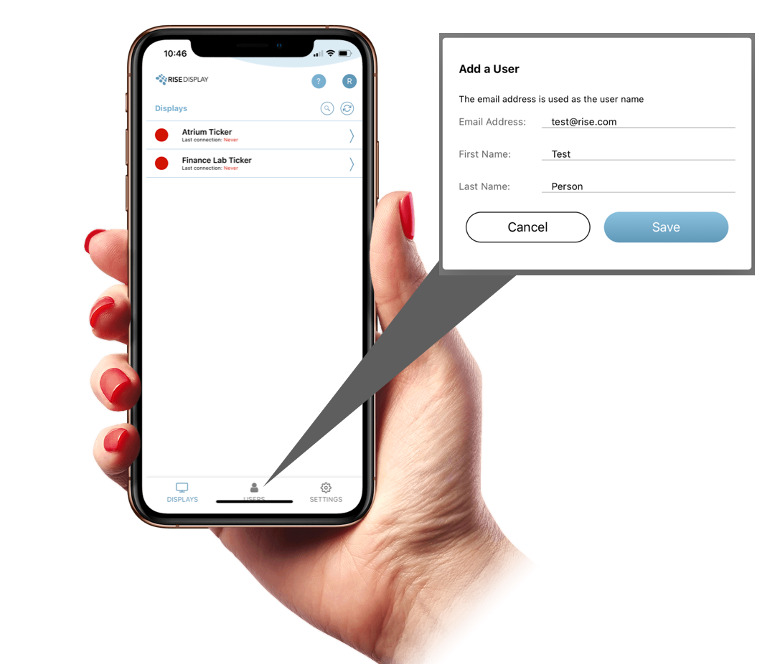
Rise Ticker App
Add users

Slide 27
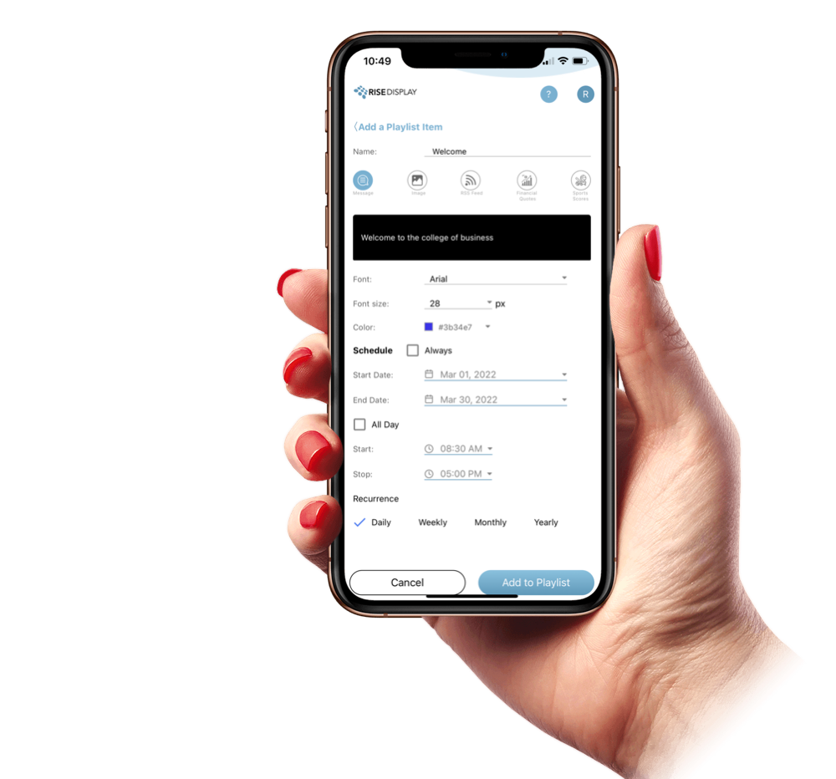
Rise Ticker App
Schedule Messages & Images

Slide 28
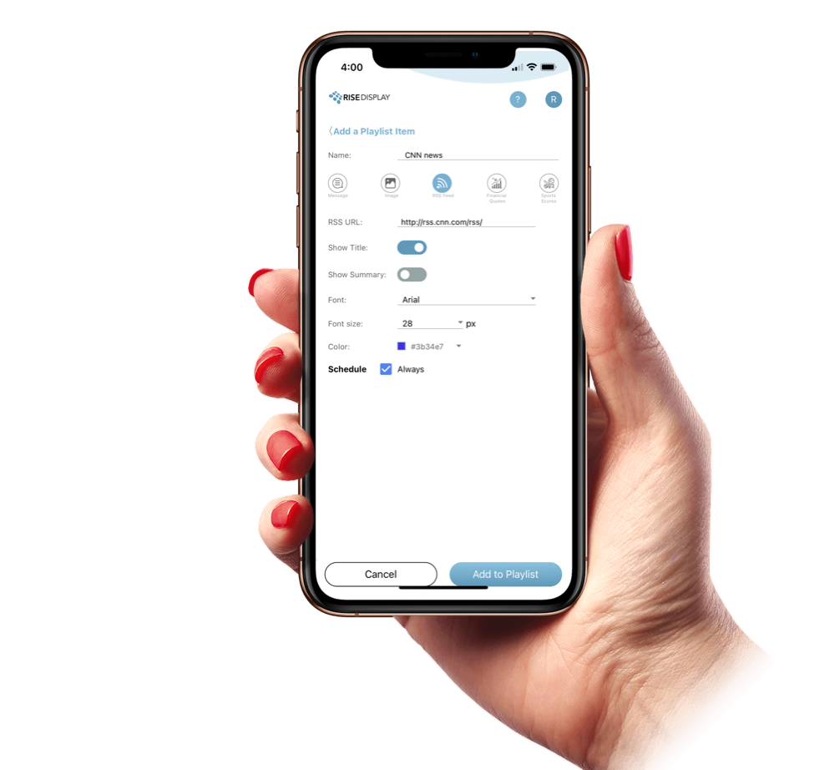
Rise Ticker App
RSS Feeds

Slide 29
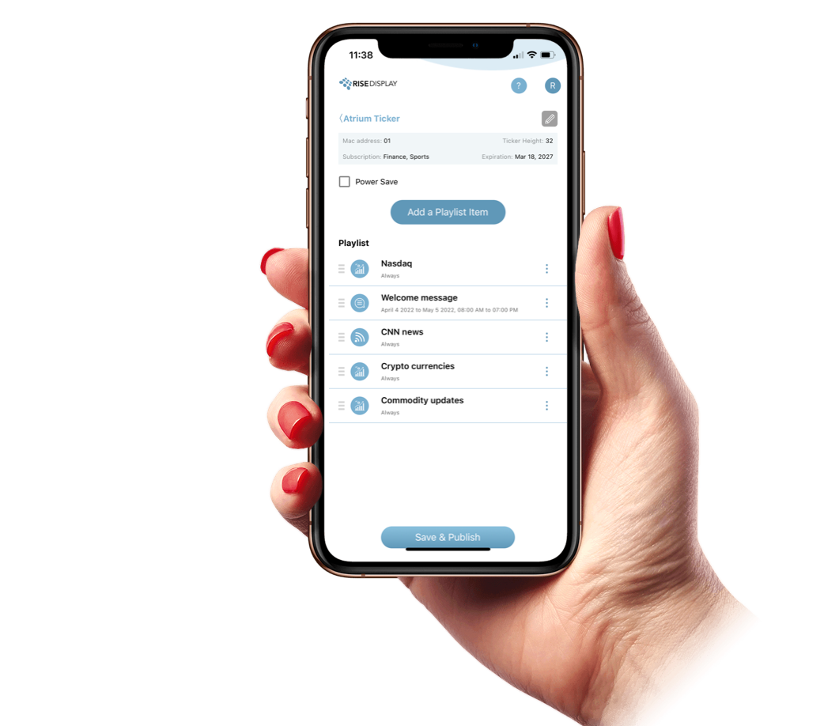
Rise Ticker App
Financial Data

Slide 30
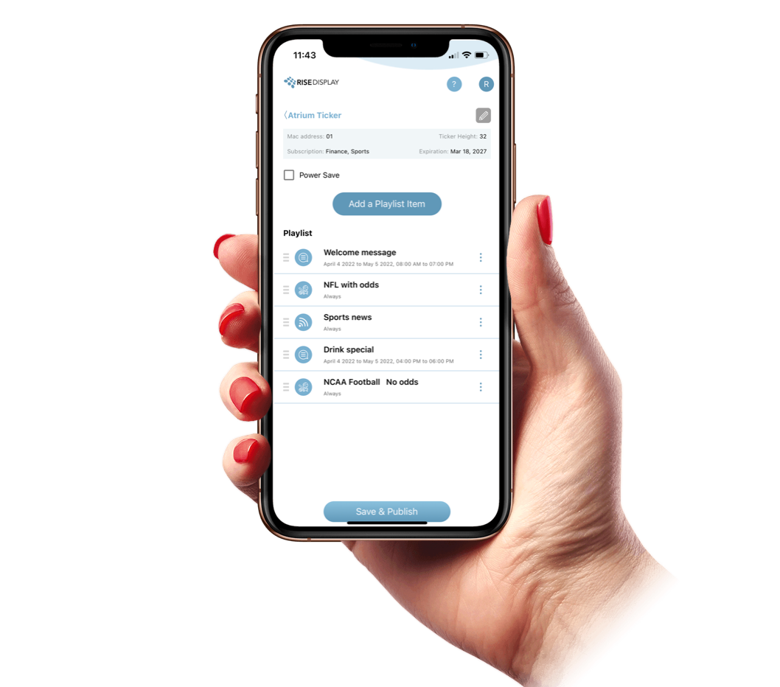
Rise Ticker App
Sports Data

Slide 31
Rise Ticker App
 | 1 Year | 3 Year 10% discount | 5 Year 20% discount | Perpetual
Ticker App for Messaging | $240 | $648 | $960 | $1,680
Ticker App with Sports or Finance | $480 | $1,296 | $1,920 | $3,360
Ticker app with Sports & Finance | $600 | $1,620 | $2,400 | $4,200
Subscription Cost

Slide 32
Why Rise?

Slide 33
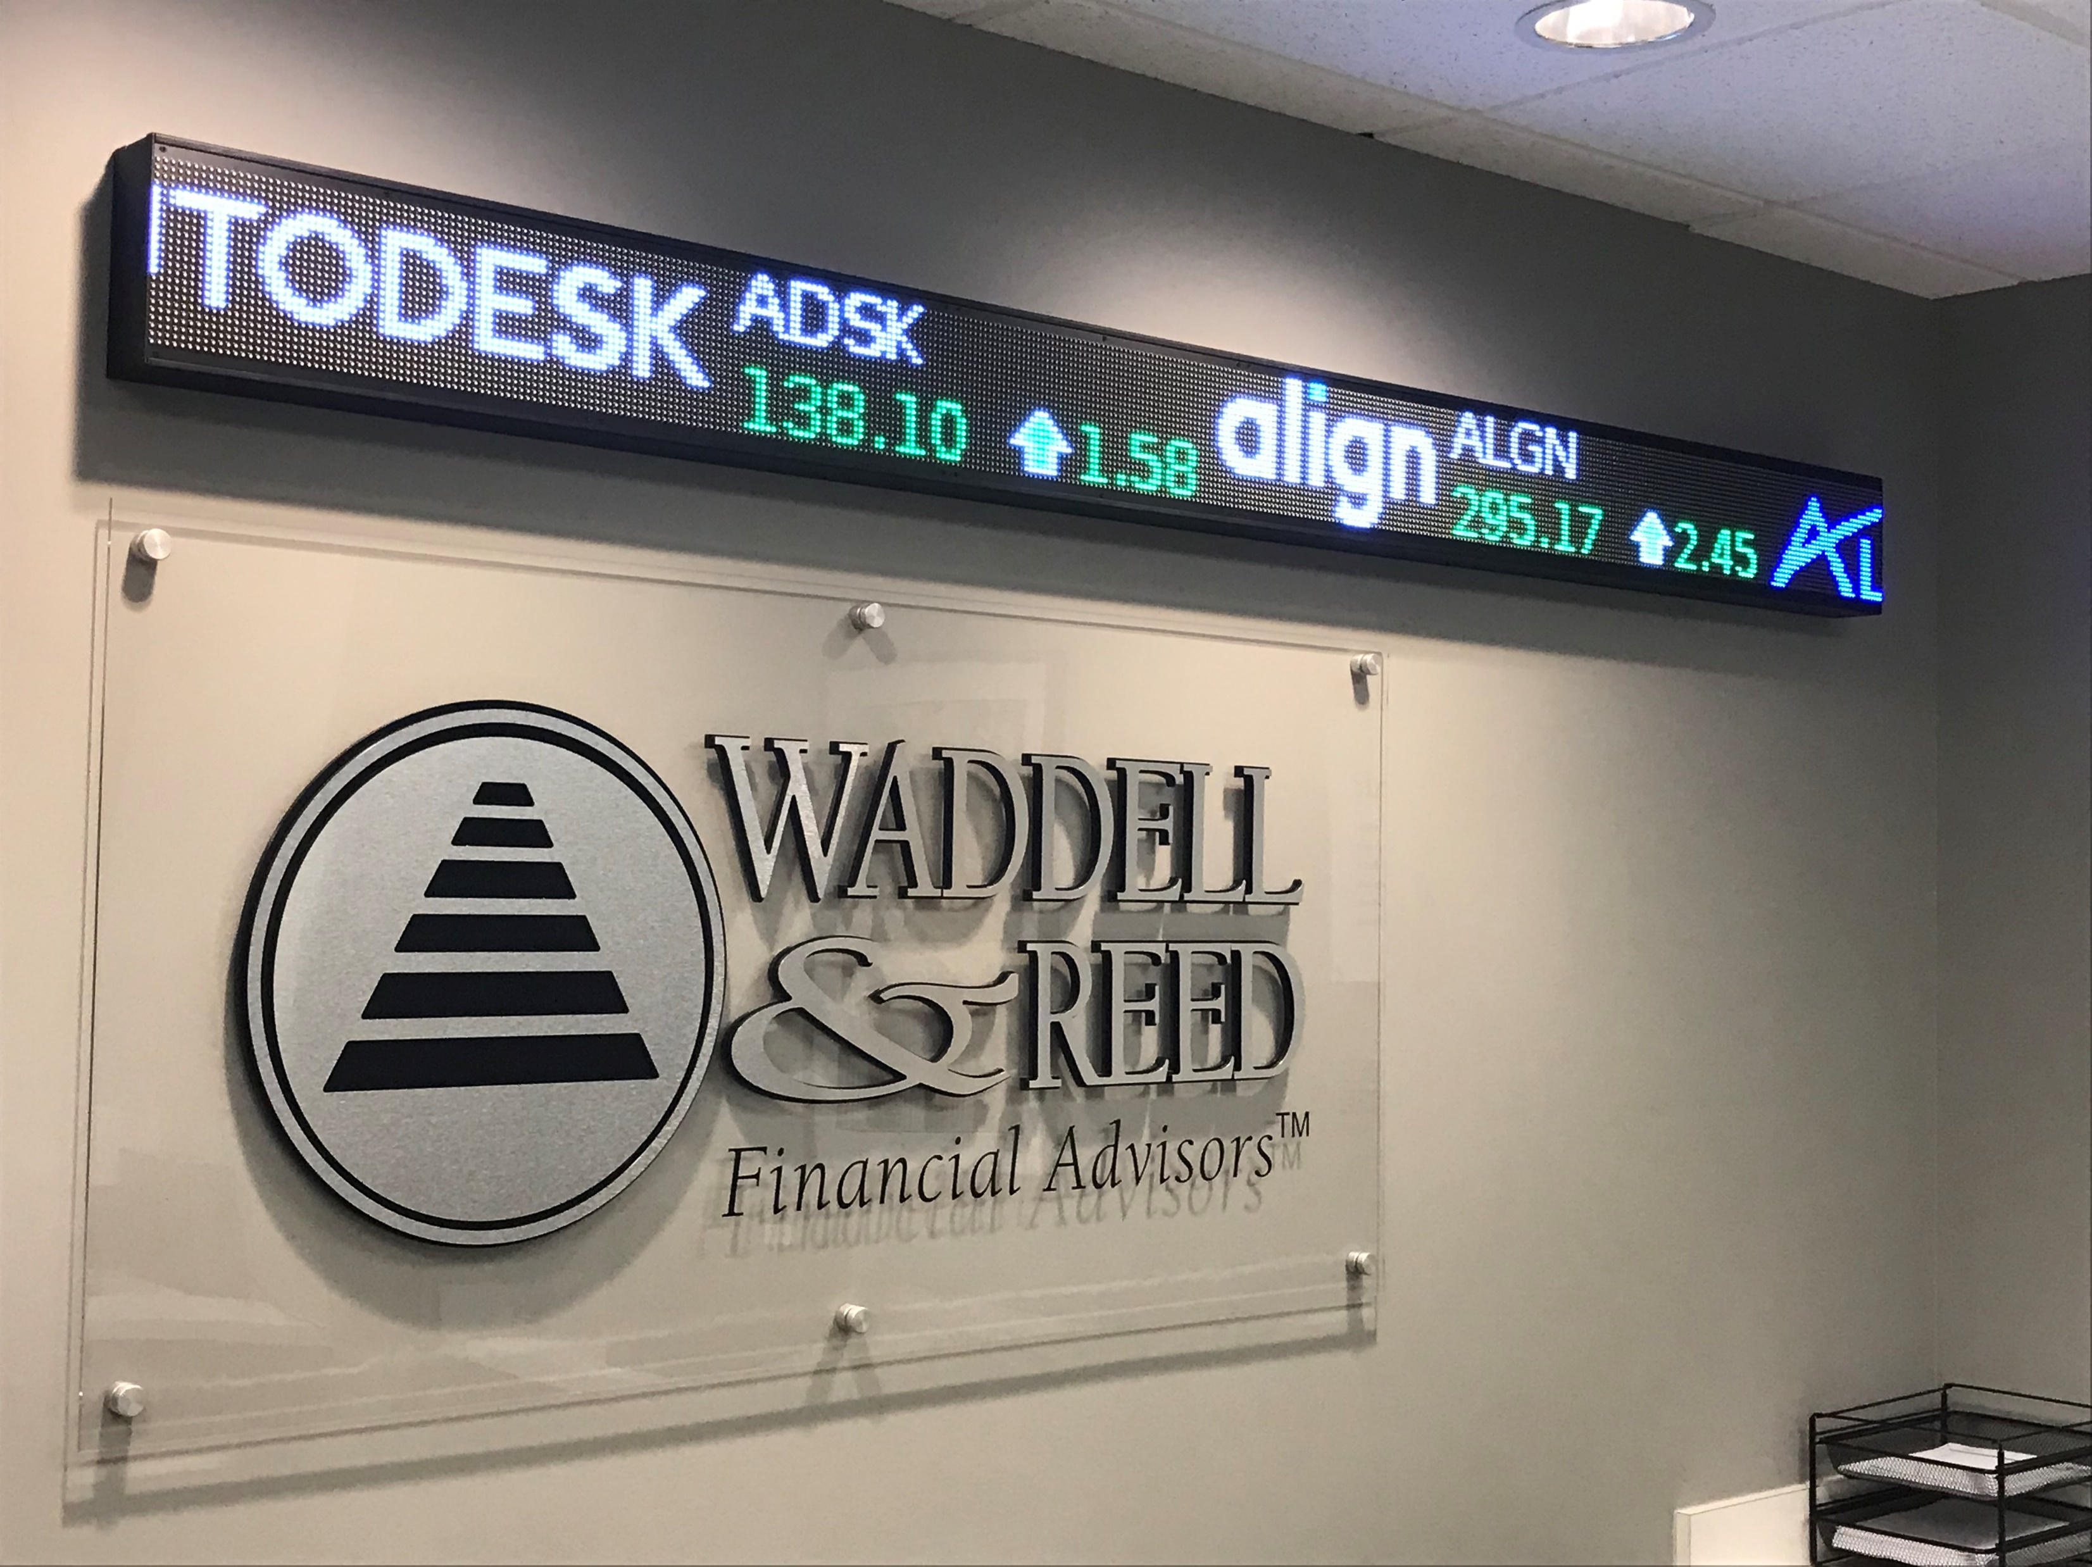
Complete Solution
Hardware
Mobile App
Licensed Data
Installation

Slide 34
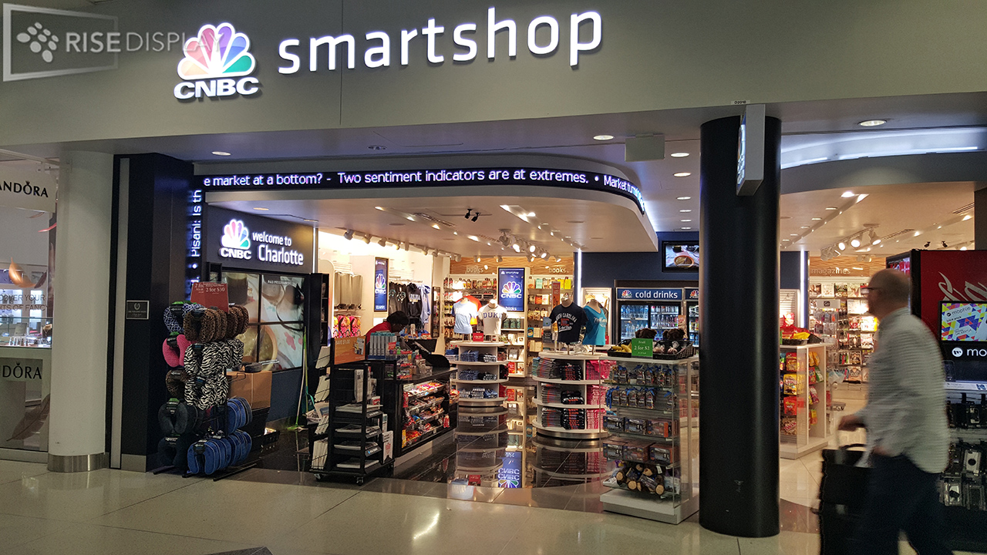
Quality
5 Year Warranty
Meets Industry Certifications
Integrated Mobile App

Slide 35
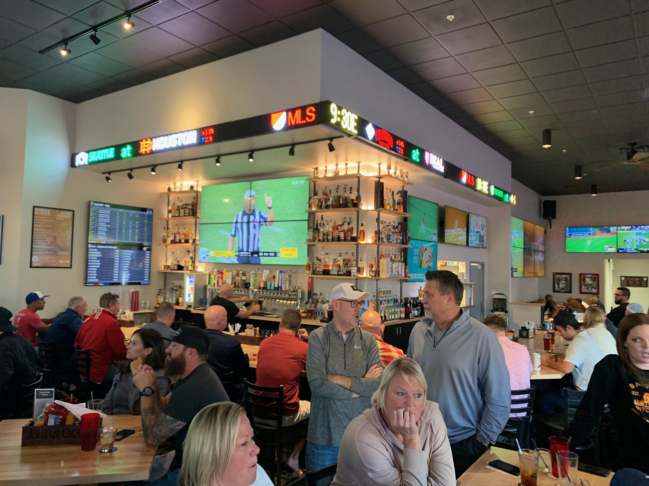
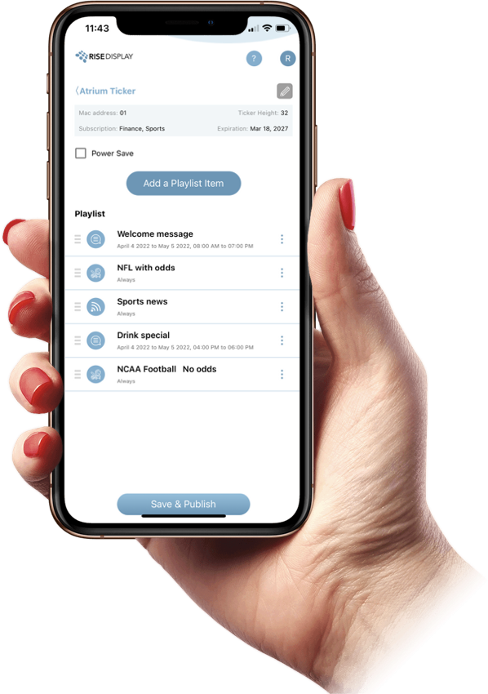
Easy to Use Mobile App
Licensed Data:
Financial Quotes
Sports Scores / Odds

Slide 36
Learn more at www.RiseDisplay.com

